Slide 1

Web scraping to gain company insights
23/11/2023

Slide 2
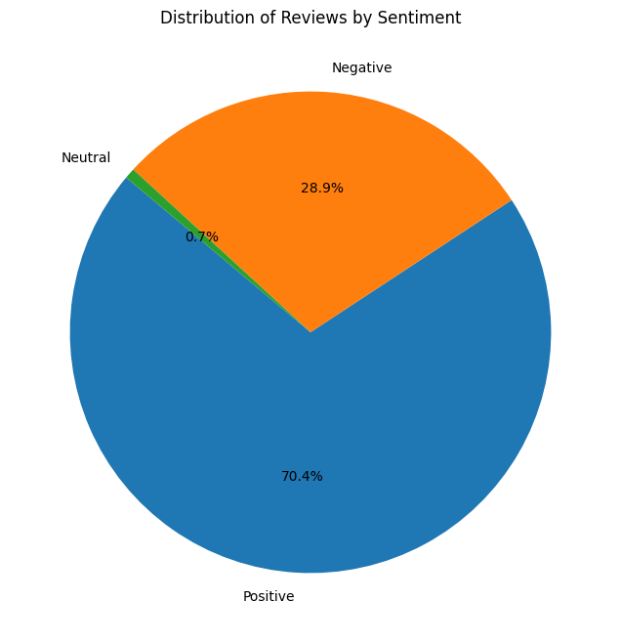
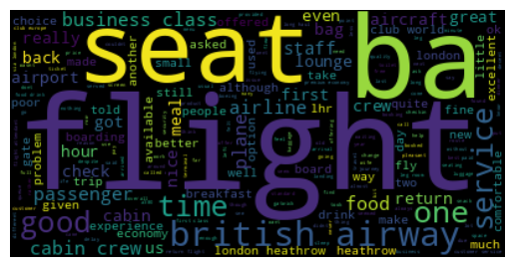
INSIGHTS FROM CUSTOMER REVIEWS
From cleaning 3700 reviews given by the customers, we obtained
Positive Reviews – 2604 (70.4%)
Negative Reviews - 1071 (28.9%)
Neutral Reviews – 26 (0.7%)
Word cloud of keywords used in reviews

